Slide 1

MODULE 3 – FUNCTIONS, ARRAYS AND STRINGS
I Year CSE B
HITS
Dennis Ritchie

Slide 2

MODULE 3 - FUNCTIONS, ARRAYS AND STRINGS(6L+6P)
Functions – Storage Class – Arrays – Strings and standard functions - Pre-processor Statements.
Practical Component :
(i) Program to compute Factorial, Fibonacci series and sum of n numbers using recursion
(ii) Program to compute sum and average of N Numbers stored in an array
(iii) Program to sort the given n numbers stored in an array
(iv) Program to search for the given element in an array
(v) Program to do word count
(vi) Program to insert a substring in a string
(vii) Program to concatenate and compare two strings
(viii) Program using pre-processor statements

Slide 3
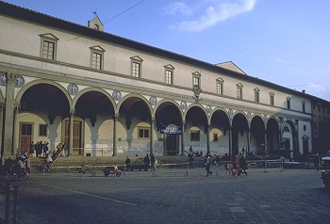
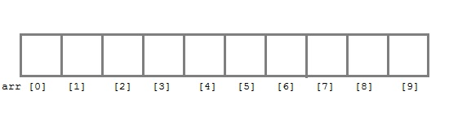
3.1Arrays
Filippo Brunelleschi, Ospdale degli Innocenti, Firenze, Italy, 1421
Arrays are referred to as structured data types
An array is defined as finite ordered collection of homogenous data, stored in contiguous memory locations.
finite means data range must be defined.
ordered means data must be stored in continuous memory addresses.
homogenous means data must be of similar data type.
Array: sequence of identical objects in memory
int a[10]; means space for ten integers

Slide 4
Where to use Arrays ?
B.TECH-COMPUTER SCIENCE AND ENGINEERING (IA-I)- SUMMATIVE ASSESSMENT -I |  |  |  |  |  |  |  | TYPE:WRITTEN TEST |  |  |  |  | CSA4101 PROBLEM SOLVING USING C
S.No | Roll No. | Name of the Students | QA.1 | QA.2 | QA.3 | QA.4 | QA.5 | QA.6 | QB.1 | QB.2 | QB.3 | Total | CO - ATTAINMENT |  | BTL - ATTAINMENT
 |  | CO's | 1 | 1 | 1 | 1 | 1 | 1 | 1 | 1 | 1 |  | CO-1 |  | BTL-1 |  | BTL-2 |  | BTL-3
 |  | BTL | 1 | 2 | 2 | 1 | 1 | 2 | 3 | 2 | 1
 |  | Max Marks | 2 | 2 | 2 | 2 | 2 | 2 | 6 | 6 | 6 | 30 | 30 | % | 12 | % | 10 | % | 6 | %
1 | 18113071 | VALLEPU ANIL | 2 | 1 | 1 | 1 | 1 | 1 | 3 | 1 | 0 | 11 | 11 | 36.7 | 5 | 42 | 3 | 30 | 3 | 30
2 | 18113072 | JESHWIN W | 1 | 0 | 1 | 2 | 0 | 0 | 0 | 0 | 0 | 4 | 4 | 13.4 | 3 | 25 | 1 | 10 | 0 | 0
3 | 18113073 | ALEXANDRE AKSHAY RAJAN FRANCIS | 2 | 0 | 2 | 1 | 2 | 0 | 0 | 6 | 0 | 13 | 13 | 43.4 | 5 | 42 | 8 | 80 | 0 | 0
4 | 18113074 | TUMATI ANIL KUMAR | 1 | 0 | 2 | 2 | 2 | 0 | 6 | 6 | 5 | 24 | 24 | 80 | 5 | 42 | 8 | 80 | 6 | 60
5 | 18113075 | SANJAY KAPILESH S | 2 | 0 | 2 | 0 | 2 | 2 | 0 | 0 | 3 | 11 | 11 | 36.7 | 4 | 33 | 2 | 20 | 0 | 0
6 | 18113076 | SHOAIB MOHAMMAD | 1 | 0 | 1 | 0 | 2 | 2 | 0 | 0 | 1 | 7 | 7 | 23.4 | 3 | 25 | 1 | 10 | 0 | 0
7 | 18113077 | SRI VISHWA B | 1 | 1 | 2 | 1 | 0 | 2 | 0 | 5 | 0 | 12 | 12 | 40 | 3 | 25 | 8 | 80 | 0 | 0
8 | 18113078 | SAURABH JAISWAL | 0 | 0 | 2 | 0 | 1 | 0 | 3 | 3 | 0 | 9 | 9 | 30 | 1 | 8.4 | 5 | 50 | 3 | 30
9 | 18113079 | NITHYA KRISHNA S KRISHNA S | 0 | 0 | 2 | 2 | 2 | 0 | 3 | 2 | 0 | 11 | 11 | 36.7 | 4 | 33 | 4 | 40 | 3 | 30
10 | 18113080 | KONDAPALLE YUVARAJ | 2 | 1 | 2 | 0 | 1 | 2 | 2 | 3 | 0 | 13 | 13 | 43.4 | 4 | 33 | 6 | 60 | 2 | 20
11 | 18113081 | SAKETH V | 2 | 2 | 2 | 1 | 2 | 2 | 3 | 6 | 0 | 20 | 20 | 66.7 | 7 | 58 | 10 | 100 | 3 | 30
12 | 18113082 | PADUCHURI PRADEEPYA LAKSHMI | 0 | 1 | 2 | 2 | 2 | 2 | 0 | 0 | 6 | 15 | 15 | 50 | 5 | 42 | 3 | 30 | 0 | 0
13 | 18113083 | PAVITHARAN R | 2 | 0 | 2 | 2 | 2 | 2 | 6 | 5 | 5 | 26 | 26 | 86.7 | 6 | 50 | 7 | 70 | 6 | 60
14 | 18113084 | SAI SIDDHARTH T | 2 | 0 | 2 | 2 | 2 | 2 | 6 | 3 | 6 | 25 | 25 | 83.4 | 6 | 50 | 5 | 50 | 6 | 60
15 | 18113085 | BOLLA RAGHU RAM REDDY | 0 | 0 | 1 | 0 | 2 | 2 | 1 | 0 | 2 | 8 | 8 | 26.7 | 2 | 17 | 1 | 10 | 1 | 10
16 | 18113086 | S ARJUNPRASANTH | 1 | 0 | 2 | 0 | 2 | 2 | 2 | 3 | 6 | 18 | 18 | 60 | 3 | 25 | 5 | 50 | 2 | 20
Sl.no | Roll No | Student Name | Marks (30) | Attendance (21)
1 | 18113071 | VALLEPU ANIL | 11 | 21
2 | 18113072 | JESHWIN W | 4 | 17
3 | 18113073 | ALEXANDRE AKSHAY RAJAN FRANCIS | 13 | 20
4 | 18113074 | TUMATI ANIL KUMAR | 24 | 21
5 | 18113075 | SANJAY KAPILESH S | 11 | 21
6 | 18113076 | SHOAIB MOHAMMAD | 7 | 20
7 | 18113077 | SRI VISHWA B | 12 | 20
8 | 18113078 | SAURABH JAISWAL | 9 | 21
9 | 18113079 | NITHYA KRISHNA S | 11 | 21
10 | 18113080 | KONDAPALLE YUVARAJ | 13 | 21
11 | 18113081 | SAKETH V | 20 | 21
12 | 18113082 | PADUCHURI PRADEEPYA LAKSHMI | 15 | 16
13 | 18113083 | PAVITHARAN R | 26 | 18
14 | 18113084 | TANNA SAI SIDDHARTHA | 25 | 20
15 | 18113085 | BOLLA RAGHU RAM REDDY | 8 | 18
16 | 18113086 | S ARJUNPRASANTH | 18 | 21
17 | 18113087 | SADAM PRIYANKA | 12 | 20
18 | 18113088 | S JASVANT DEV SARAVANAN | 30 | 17
19 | 18113089 | TULABANDU AADITHYA KIRAN | 24 | 20
to store list of Employee or Student names,
to store marks of students,
or to store list of numbers or characters etc

Slide 5
3.1.1How to use Arrays ?
Declaring an Array
data-type variable-name[size];
Example: char arr[10];
Initialization of an Array
After an array is declared it must be initialized. Otherwise, it will contain garbage value(any random value).
An array can be initialized at either compile time or at runtime.

Slide 6
3.1.1How to use Arrays ?
Compile time Array initialization
Compile time initialization of array elements is same as ordinary variable initialization.
data-type array-name[size] = { list of values };
/* Here are a few examples */
int marks[4]={ 67, 87, 56, 77 }; // integer array initialization
float area[5]={ 23.4, 6.8, 5.5 }; // float array initialization
int marks[4]={ 67, 87, 56, 77, 59 }; // Compile time error

Slide 7
3.1.1How to use Arrays ?
Runtime Array initialization (with user specific value)
An array can also be initialized at runtime using scanf() function.
#include<stdio.h>
void main()
{
int arr[4];
int i, j;
for(i = 0; i < 4; i++)
{
printf("Enter Student %d mark:” , i);
scanf("%d", &arr[i]); //Run time array initialization
}
for(j = 0; j < 4; j++)
{
printf("%d\n", arr[j]);
}
}

Slide 8
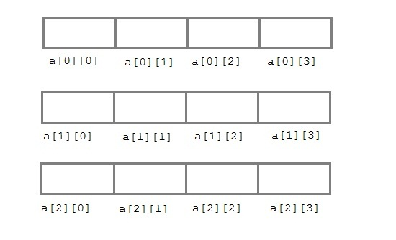
3.1.2 Two dimensional Arrays
C language supports multidimensional arrays also.
The simplest form of a multidimensional array is the two-dimensional array. Both the row's and column's index begins from 0.
Two-dimensional arrays are declared as follows,
data-type array-name[row-size][column-size]
/* Example */
int a[3][4];

Slide 9

3.1.3 Multidimensional Arrays
Array declarations read right-to-left
int a[10][3][2];
“an array of ten arrays of three arrays of two ints”
In memory
Seagram Building, Ludwig Mies van der Rohe,1957
3
3
3
...
2
2
2
2
2
2
2
2
2
10

Slide 10
3.1.3 multidimensional Arrays
#include<stdio.h>
void main()
{
int arr[3][4];
int i, j, k;
printf("Enter array element: ");
for(i = 0; i < 3;i++)
{
for(j = 0; j < 4; j++)
{
scanf("%d", &arr[i][j]);
}
}
printf(“\nEntered array element are: ");
for(i = 0; i < 3; i++)
{
printf(“\n”);
for(j = 0; j < 4; j++)
{
printf(“%d, ", arr[i][j]);
}
}
}
Enter array element:
1,2,3,4,5,6,7,8,9,10,11,12
Entered array element are:
1, 2, 3, 4,
5, 6, 7, 8,
9,10 , 11, 12

Slide 11
Compiling your program on Unix
vi file_name.c // used to create & edit the program
(press Esc and Semicolon ) :wq // to save the file
cc file_name.c // used for compiling the program and create a.out (default output file)
Example:: cc hello.c
./a.out // execution of program
cc file_name.c -o file_name // used for creating file_name.out
./file_name.out

Slide 12
3.2 Functions in C
A function is a block of code that performs a particular task.
C functions can be classified into two categories,
1. Library (or Predefined) functions
2. User-defined functions

Slide 13
3.2 Functions in C
Library functions are those functions which are already defined in C library,
example printf(), scanf(), strcat() etc.
A User-defined functions, are those functions which are defined by the user at the time of writing program.
These functions are made for code reusability and for saving time and space.

Slide 14
3.2 Functions in C
Benefits of Using Functions
It provides modularity to your program's structure.
It makes your code reusable. You just have to call the function by its name to use it, wherever required.
In case of large programs with thousands of code lines, debugging and editing becomes easier if you use functions.
It makes the program more readable and easy to understand.

Slide 15
3.2.1 Function Declaration
A function must also be declared before its used
General syntax for function declaration is,
returntype (int, float, char, double) or void.
function name - valid C identifier
parameter list -type and no of arguments /when it is called
formal parameters
terminating semicolon
returntype functionName (type1 parameter1, type2 parameter2,...);

Slide 16
3.2.2 Function definition Syntax
function header
function body
No semicolon(;) after the parenthesis in the function header
returntype functionName(type1 parameter1, type2 parameter2,...)
{
// function body goes here
}

Slide 17
3.2.3 Function Example
#include<stdio.h>
int multiply(int a, int b); // function declaration
int main()
{
int i, j, result;
printf("Please enter 2 numbers you want to multiply...");
scanf("%d%d", &i, &j);
result = multiply(i, j); // function call
printf("The result of muliplication is: %d", result);
return 0;
}
int multiply(int a, int b)
{
return (a*b); // function defintion, this can be done in one line
}

Slide 18
3.2.3 Function Example
#include<stdio.h>
int multiply(int a, int b); // function declaration
int main()
{
int i, j, result;
printf("Please enter 2 numbers you want to multiply...");
scanf("%d%d", &i, &j);
result = multiply(i, j); // function call
printf("The result of muliplication is: %d", result);
return 0;
}
int multiply(int a, int b)
{
return (a*b); // function defintion, this can be done in one line
}

Slide 19
3.2.2 Function Example -ncr
#include<stdio.h>
int factorial(int a);
int main()
{
int n, r, result, n_fact, r_fact,n_r_fact;
clrscr();
printf("\n Calculation of nCr value");
printf("\n_____________________");
printf("\n Please enter n and r values (note n>r) : ");
scanf("%d, %d", &n, &r);
n_fact=factorial(n);
n_r_fact=factorial(n-r);
r_fact=factorial(r);
result=((n_fact)/(n_r_fact* r_fact));
printf("\nThe result of n_fact is: %d", n_fact);
printf("\nThe result of n-r_fact is: %d", n_r_fact);
printf("\nThe result of r_fact is: %d", r_fact);
printf("\nThe result of nCr is: %d", result);
getch();
return 0;
}
int factorial(int a)
{
int fact=1;
while( a>=1)
{
fact=fact*a;
a=a-1;
}
return (fact);
}

Slide 20
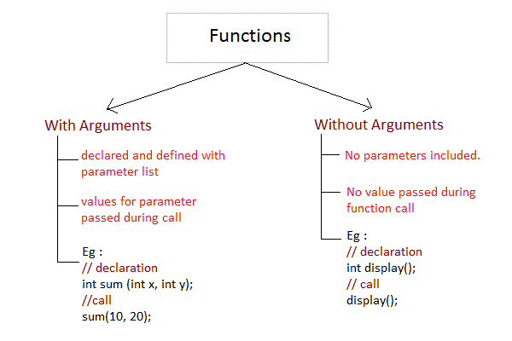
3.2.4 Passing Arguments to a function
Arguments are the values specified during the function call, for which the formal parameters are declared while defining the function.

Slide 21
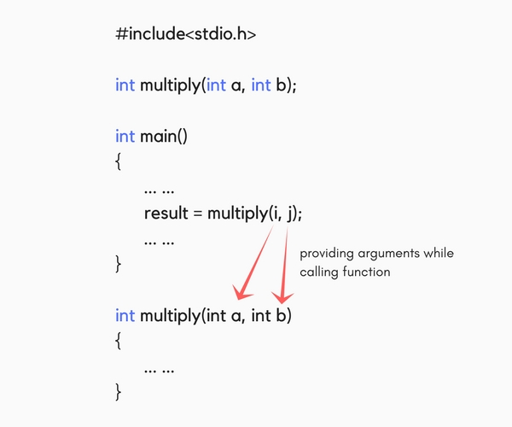
3.2.4 Passing Arguments to a function

Slide 22
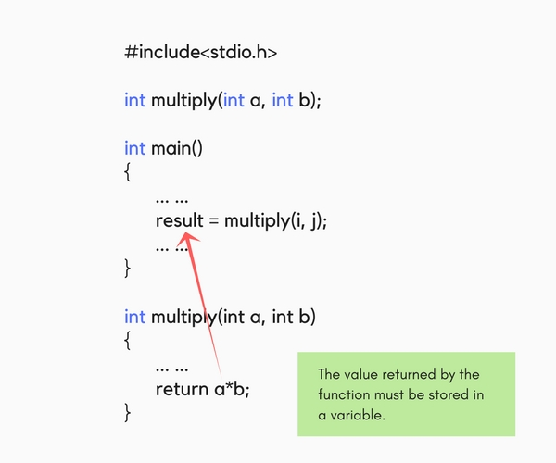
3.2.5 Returning a value from function
A function may or may not return a result. But if it does, we must use the return statement to output the result.

Slide 23
3.2.6 Type of User-defined Functions in C
There can be 4 different types of user-defined functions, they are:
1. Function with no arguments and no return value
2. Function with no arguments and a return value
3. Function with arguments and no return value
4. Function with arguments and a return value

Slide 24
3.2.6 Type of User-defined Functions in C
#include<stdio.h> // Function with no arguments and no return value
void greatNum(); // function declaration
int main()
{
greatNum(); // function call
return 0;
}
void greatNum() // function definition
{
int i, j;
printf("Enter 2 numbers that you want to compare...");
scanf("%d%d", &i, &j);
if(i > j) {
printf("The greater number is: %d", i);
}
else {
printf("The greater number is: %d", j);
}
}

Slide 25
3.2.6 Type of User-defined Functions in C
#include<stdio.h> // Function with no arguments and a return value
int greatNum(); // function declaration
int main()
{
int result;
result = greatNum(); // function call
printf("The greater number is: %d", result);
return 0;
}
int greatNum() // function definition
{
int i, j, greaterNum;
printf("Enter 2 numbers that you want to compare...");
scanf("%d%d", &i, &j);
if(i > j) {
greaterNum = i;
}
else {
greaterNum = j;
}
// returning the result
return greaterNum;
}

Slide 26
3.2.6 Type of User-defined Functions in C
#include<stdio.h> // Function with arguments and no return value
void greatNum(int a, int b); // function declaration
int main()
{
int i, j;
printf("Enter 2 numbers that you want to compare...");
scanf("%d%d", &i, &j);
greatNum(i, j); // function call
return 0;
}
void greatNum(int x, int y) // function definition
{
if(x > y) {
printf("The greater number is: %d", x);
}
else {
printf("The greater number is: %d", y);
}
}

Slide 27
3.2.7 Nesting of Functions
Call a function inside another function's body.
We must be careful while using nested functions, because it may lead to infinite nesting.
function1()
{
// function1 body here
function2();
// function1 body here
}
function2()
{
// function2 body here
function1();
// function2 body here
}

Slide 28
3.2.8 What is Recursion?
Recursion is a special way of nesting functions, where a function calls itself inside it.
We must have certain conditions in the function to break out of the recursion, otherwise recursion will occur infinite times.
function1()
{
// function1 body here
function1();
// function1 body here
}

Slide 29
3.2.8 Recursion Example
#include<stdio.h> //Factorial of a number using Recursion
int factorial(int x); //declaring the function
void main()
{
int a, b;
printf("Enter a number...");
scanf("%d", &a);
b = factorial(a); //calling the function named factorial
printf("%d", b);
}
int factorial(int x) //defining the function
{
int r = 1;
if(x == 1)
return 1;
else
r = x*factorial(x-1); //recursion, since the function calls itself
return r;
}

Slide 30
3.2.9 Types of Function calls in C
Based on how we specify the arguments, we can call a function in two different ways
Call by Value
Call by Reference
Calling a function by value means, we pass the values of the arguments which are stored or copied into the formal parameters of the function. Hence, the original values are unchanged only the parameters inside the function changes.
In call by reference we pass the address(reference) of a variable as argument to any function. When we pass the address of any variable as argument, then the function will have access to our variable, as it now knows where it is stored and hence can easily update its value.

Slide 31
3.2.9 Types of Function calls in C
#include<stdio.h> // Example for Call by value
void calc(int x);
int main()
{
int x = 10;
calc(x);
// this will print the value of 'x'
printf("\nvalue of x in main is %d", x);
return 0;
}
void calc(int x)
{
// changing the value of 'x'
x = x + 10 ;
printf("value of x in calc function is %d ", x);
}
value of x in calc function is 20
value of x in main is 10

Slide 32
3.2.9 Types of Function calls in C
#include<stdio.h> // Example for Call by Refernce
void calc(int *p); // function taking pointer as argument
int main()
{
int x = 10;
calc(&x); // passing address of 'x' as argument
printf("value of x is %d", x);
return(0);
}
void calc(int *p) //receiving the address in a reference pointer variable
{
// changing the value directly that is stored at the address passed
*p = *p + 10;
}
value of x is 20

Slide 33
3.2.9 Types of Function calls in C
# include<stdio.h> // Fibonacci Series with normal function
void fibo(int x);
void main()
{
int a;
clrscr();
printf("\n Enter the size of Fibonacci Series: ");
scanf("%d", &a);
printf("The first %d terms of Fibonacci Series are:\n\n");
printf("%d ",1);
fibo(a);
}
void fibo(int x)
{
int i,first=0, second=1,sum;
for(i=1; i<x; i++)
{
sum=first+second;
first=second;
second=sum;
printf("%d ",sum);
}
getch();
}

Slide 34
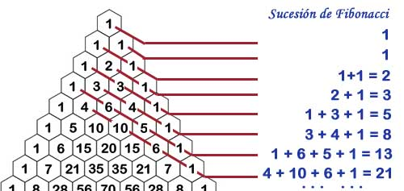
3.2.9 Types of Function calls in C
void fibo(int x)
{
static int first=0, second=1,sum;
if(x>1)
{
sum=first+second;
first=second;
second=sum;
printf("%d ",sum);
fibo(x-1);
}
else
printf("\n\n");
getch();
}
# include<stdio.h> // Fibonacci Series using Recursion
void fibo(int x);
void main()
{
int a;
clrscr();
printf("\n Enter the size of Fibonacci Series: ");
scanf("%d", &a);
printf("The first %d terms of Fibonacci Series are:\n\n");
printf("%d ",1);
fibo(a);
}

Slide 35
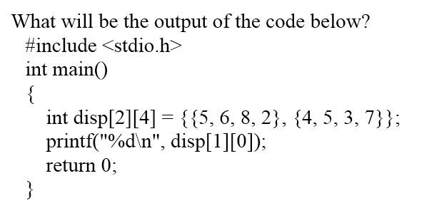
Output:
4

Slide 36
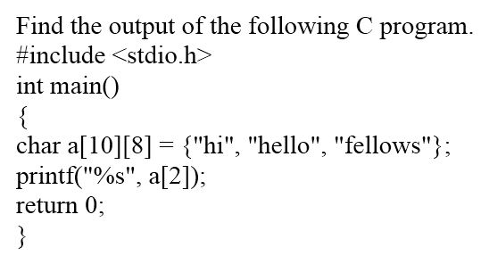
Output:
a) fellows
a) fellows
b) h
c) fello
d) Compiler error

Slide 37
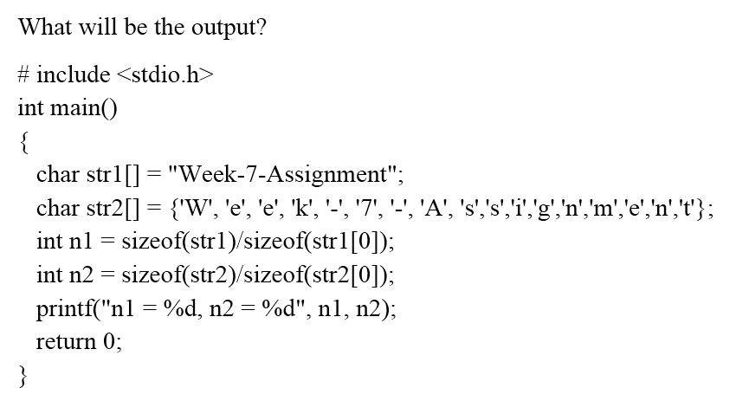
Output:
a) n1=18, n2=17
a) n1=18, n2=17
b) n1=18, n2=18
c) n1=17, n1=17
d) n1=17, n2=18

Slide 38
3.3 String and Character Array
String is a sequence of characters that is treated as a single data item and terminated by null character '\0’.
Remember that C language does not support strings as a data type.
A string is actually one-dimensional array of characters in C language.
These are often used to create meaningful and readable programs.
The string "hello world" contains 12 characters including '\0' character which is automatically added by the compiler at the end of the string.

Slide 39
3.3.1 Declaring and Initializing a string variables
There are different ways to initialize a character array variable.
char name[10] = “Hindustan"; // valid character array initialization
char name[10] = {‘H',’i',’n',’d',’u',’s',’t’, ’a,’n','\0'}; // valid initialization
Remember that when you initialize a character array by listing all of its characters separately then you must supply the '\0' character explicitly.
Some examples of illegal initialization of character array are,
char ch[3] = "hell"; // Illegal
char str[4];
str = "hell"; // Illegal

Slide 40
3.3.1 Declaring and Initializing a string variables
Example
include<stdio.h>
void main()
{
char str[20];
printf("Enter a string : ");
scanf("%[^\n]", &str); //scanning the whole string, including the white spaces
printf("%s", str);
}
Alternate way using gets() function
char text[20];
gets(text);
printf("%s", text);

Slide 41
3.4 String Handling Functions
C language supports a large number of string handling functions that can be used to carry out many of the string manipulations.
These functions are packaged in string.h library.
Need to include string.h header file in your programs to use these functions.
The following are the most commonly used string handling functions.
Method | Description
strcat(s1,s2) | Concatenates the character string s2 to the end of s1, placing a null character at the end of the final string. The function returns s1.
strlen(s) | Returns the number of characters in s, excluding the null character.
strrev(s) | It is used to show reverse of a string
strcpy(s1,s2) | Copies the string s2 to s1, returning s1.
strcmp(s1,s2) | Compares strings s1 and s2 and returns a value less than zero if s1 is less than s2, equal to zero if s1 is equal to s2, and greater than zero if s1 is greater than s2.

Slide 42
3.4 String Handling Functions
Method | Description
strncat (s1, s2, n) | Copies s2 to the end of s1 until either the null character is reached or n characters have been copied, whichever occurs first. Returns s1.
strncmp (s1, s2, n) | Performs the same function as strcmp, except that at most n characters from the strings are compared.
strncpy (s1, s2, n) | Copies s2 to s1 until either the null character is reached or n characters have been copied, whichever occurs first. Returns s1.
strchr (s, c) | Searches the string s for the first occurrence of the character c. If it is found, a pointer to the character is returned; otherwise, a null pointer is returned.

Slide 43
3.4 String Handling Functions
strrch(s,c)
strstr(s1,s2)
strpbrk(s,c)
stricmp (s1, s2)
strlwr(s)
strupr(s)

Slide 44
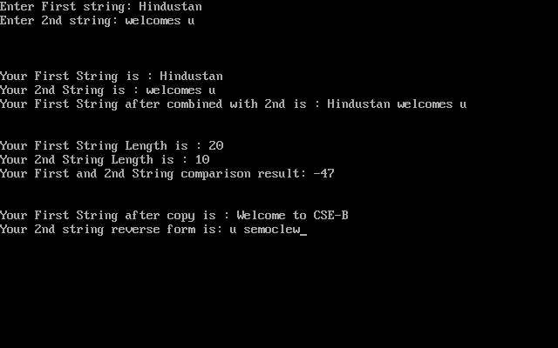
3.4 String Handling Functions
#include<stdio.h>
#include<string.h>
int main()
{
char s1[50];
char s2[50];
int i, j, k;
clrscr();
printf("Enter First string: ");
gets(s1);
printf("Enter 2nd string: ");
gets(s2);
printf("\n\n\nYour First String is : %s", s1);
printf("\nYour 2nd String is : %s", s2);
printf("\nYour First String after combined with 2nd is : %s",strcat(s1,s2) );
i=strlen(s1), j=strlen(s2);
k=strcmp(s1,s2);
printf("\n\n\nYour First String Length is : %d", i);
printf("\nYour 2nd String Length is : %d", j);
printf("\nYour First and 2nd String comparison result: %d", k);
strcpy(s1, "Welcome to CSE-B");
printf("\n\n\nYour First String after copy is : %s", s1);
printf("\nYour 2nd string reverse form is: %s",strrev(s2));
getch();
return(0);
}

Slide 45
3.5 Storage classes in C
Storage classes are
1. Automatic variables
2. External variables
3. Static variables
4. Register variables
Scope i.e where the value of the variable would be available inside a program.
Default initial value i.e if we do not explicitly initialize that variable, what will be its default initial value.
Lifetime of that variable i.e for how long will that variable exist.

Slide 46
3.5.1 Automatic variables: auto
A variable declared inside a function without any storage class specification, is by default an automatic variable.
They are created when a function is called and are destroyed automatically when the function's execution is completed.
Automatic variables can also be called local variables because they are local to a function.
Scope: Variable defined with auto storage class are local to the function block inside which they are defined.
Default Initial Value: Any random value i.e garbage value.
Lifetime: Till the end of the function/method block where the variable is defined.

Slide 47
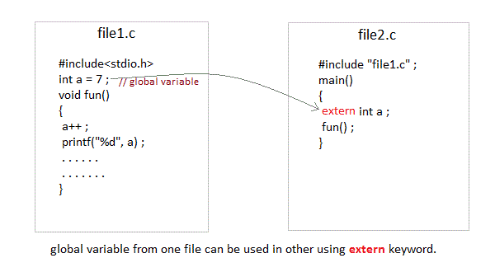
3.5.2 External or Global variable
A variable that is declared outside any function is a Global Variable.
Global variables remain available throughout the program execution.
By default, initial value of the Global variable is 0(zero).
One important thing to remember about global variable is that their values can be changed by any function in the program
The extern keyword is used with a variable to inform the compiler that this variable is declared somewhere else. The extern declaration does not allocate storage for variables.
Scope: Global i.e everywhere in the program. These variables are not bound by any function, they are available everywhere.
Default initial value: 0(zero).
Lifetime: Till the program doesn't finish its execution, you can access global variables.

Slide 48
3.5.3 Static variables
A static variable tells the compiler to persist/save the variable until the end of program.
Instead of creating and destroying a variable every time when it comes into and goes out of scope, static variable is initialized only once and remains into existence till the end of the program.
A static variable can either be internal or external depending upon the place of declaration.
Scope of internal static variable remains inside the function in which it is defined. External static variables remain restricted to scope of file in which they are declared.
Scope: Local to the block in which the variable is defined
Default initial value: 0(Zero).
Lifetime: Till the whole program doesn't finish its execution.

Slide 49
3.5.3 Static variables
#include<stdio.h>
void test(); //Function declaration
int main()
{
test();
test();
test();
}
void test()
{
static int a = 0; //a static variable
a = a + 1;
printf("%d\t",a);
}
Output:
1 2 3

Slide 50
3.5.4 Register variable
Register variables inform the compiler to store the variable in CPU register instead of memory.
Register variables have faster accessibility than a normal variable. Generally, the frequently used variables are kept in registers.
But only a few variables can be placed inside registers.
One application of register storage class can be in using loops, where the variable gets used a number of times in the program, in a very short span of time.
Syntax :
register int number;
Scope: Local to the function in which it is declared.
Default initial value: Any random value i.e garbage value
Lifetime: Till the end of function/method block, in which the variable is defined.

Slide 51
3.5.5 Which storage class should be used and when
We should use static storage class only when we want the value of the variable to remain same every time we call it using different function calls.
We should use register storage class only for those variables that are used in our program very oftenly. CPU registers are limited and thus should be used carefully.
We should use external or global storage class only for those variables that are being used by almost all the functions in the program.
If we do not have the purpose of any of the above mentioned storage classes, then we should use the automatic storage class.

Slide 52
3.6 C Preprocessor
Topics to be covered
Macros
Preprocessor Directives
Predefined Macros
Preprocessor Operators

Slide 53
3.6 C Preprocessor
Topics to be covered
Preprocessor Directives
Macros
Predefined Macros
Preprocessor Operators

Slide 54
3.6.1 Preprocessor Directives
Sr.No. | Directive & Description
1 | #define Substitutes a preprocessor macro.
2 | #include Inserts a particular header from another file.
3 | #undef Undefines a preprocessor macro.
4 | #ifdef Returns true if this macro is defined.
5 | #ifndef Returns true if this macro is not defined.
6 | #if Tests if a compile time condition is true.
7 | #else The alternative for #if.
8 | #elif #else and #if in one statement.
9 | #endif Ends preprocessor conditional.
10 | #error Prints error message on stderr.
C Preprocessor is just a text substitution tool and it instructs the compiler to do required pre-processing before the actual compilation.
All preprocessor commands begin with a hash symbol (#).

Slide 55
3.6.2 Predefined Macros
Sr.No. | Macro & Description
1 | __DATE__ The current date as a character literal in "MMM DD YYYY" format.
2 | __TIME__ The current time as a character literal in "HH:MM:SS" format.
3 | __FILE__ This contains the current filename as a string literal.
4 | __LINE__ This contains the current line number as a decimal constant.
5 | __STDC__ Defined as 1 when the compiler complies with the ANSI standard.
A macro is a name given to a block of C statements as a pre-processor directive.
Being a pre-processor, the block of code is communicated to the compiler before entering into the actual coding (main () function).
A macro is defined with the preprocessor directive, #define.

Slide 56
3.6.2 Predefined Macros
#include <stdio.h> // File name preprocessor.c
int main()
{
printf("File :%s\n", __FILE__ );
printf("Date :%s\n", __DATE__ );
printf("Time :%s\n", __TIME__ );
printf("Line :%d\n", __LINE__ );
printf("ANSI :%d\n", __STDC__ );
}
File : preprocessor.c
Date :Oct 12 2018
Time :09:36:24
Line :7
ANSI :1

Slide 57
3.6.3 Preprocessor Operators
The Macro Continuation (\) Operator
A macro is normally confined to a single line. The macro continuation operator (\) is used to continue a macro that is too long for a single line.
The Stringize (#) Operator
The stringize or number-sign operator ( '#' ), when used within a macro definition, converts a macro parameter into a string constant
#include <stdio.h>
#define message_for(a, b) \
printf(#a " and " #b ": We love you!\n")
int main(void) {
message_for(Raj, Sekar);
return 0;
}

